Slide 1
Agricultural Study
Consensus Meeting – Part 2:
Economic Health of the Agricultural Sector
Overview
Government Support
Crop Insurance
Anti-trust
Ag Study Committee
Mary Theresa Downing
Sue Hnastchenko
Cathy Rude
Mary Trippler
Amy Wenner
March 13, 2014
LEAGUE OF WOMEN VOTERS® of SOUTH TONKA
Serving Deephaven, Excelsior, Greenwood, Shorewood, Tonka Bay, Woodland

Slide 2
Overview
Amy Wenner

Slide 3
Notes:
In the 1920s, farm households accounted for more than 25% of the U.S. workforce and generated approximately 8% of gross domestic product
Today they account for only 1.6 percent of the work force and generate approximately 1 percent of GDP.
Over the same period, the rural share of the population has fallen far less, from 49 percent to 19 percent, suggesting that rural areas are less dependent on farming's contribution to the rural economy
Fewer farms today, but larger commercial operations producing the bulk of farm commodities:
commercial farms make up the other 10 percent of the sector, but account for 83 percent of the value of U.S. production
90% of all farms are considered small, less than $250,000 in gross sales

Slide 4
Farm Income
Fifty years ago:
Average household income for the farm population was approximately half that of the general population.
2011:
Average household income for the farm population was about 13 percent higher than the general population.
For commercial farms, two and a half times that of the general population.
Notes:
Partly due to USDA definition of farms, which includes those where the principal operator is retired or lists a main occupation other than farming.
Also do to income diversification – by 2000, 93% of farm households had income from off-farm sources (outside jobs, investments, social security, etc.) = less vulnerable to the fluctuations of farm income.

Slide 5
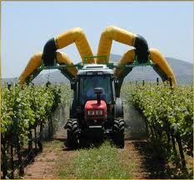
Other Trends in U.S. Agriculture
Aging farm population
Farm operations increasingly specialized
Farms more reliant on science and new technologies
Barriers to entry
Growing demand for U.S. agricultural exports
Higher incidences of natural disasters due to climate change
Increased pressures on environment and agricultural lands
Notes:
Aging Population
1978: 16.4% of principal farm operators were over age 65; 2007: approx. 30%
Increasingly Specialized
1900 - a farm produced an average of about 5 commodities; by 2000, the average had fallen to just over 1
Reliance on science and new technologies: constant pressure to produce more with less and to conserve natural resources
Crops: field sensors for water, nutrients and soil to manage water & fertilize applications; satellite & GPS
Livestock: IT to adjust feed mixes and climate controls to meet need of animals in confined feeding operations.
Technical advice: latest R&D research findings and general assistance widely available through state extension services
Barriers to entry: Expensive, average farm assets just below $1 million.
Growing demand for U.S. ag exports: exports account for around 31% of gross farm cash income, will rise as global population continues to increase, especially in food and water-poor countries
Natural disasters: drought, flood, fires, extreme temps, storms, earthquakes, hurricanes, tornadoes

Slide 6
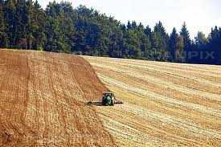
Agricultural Pressures on the Environment
Global food production:
Uses one-quarter of all the habitable land on earth
Accounts for more than 70 percent of fresh water consumption
Produces more than 30% of global greenhouse emissions
Accounts for 80% of deforestation
Single largest cause of species and biodiversity loss

Slide 7
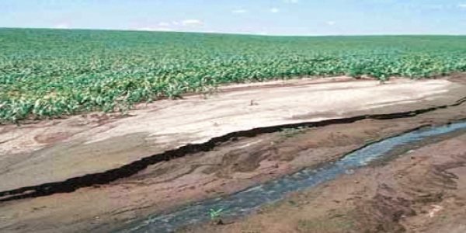
Agricultural Pressures on the Environment
Water
Agriculture accounts for 80-90% of the nation’s consumptive water use, and is the biggest polluter of waterways through chemical and soil runoff.
Soil
Intensive agriculture increases soil loss through erosion, and negatively affects soil quality through chemical applications and monocropping.
Notes:
“A nation that destroys its soil destroys itself.” - Franklin D. Roosevelt ^{F}

Slide 8
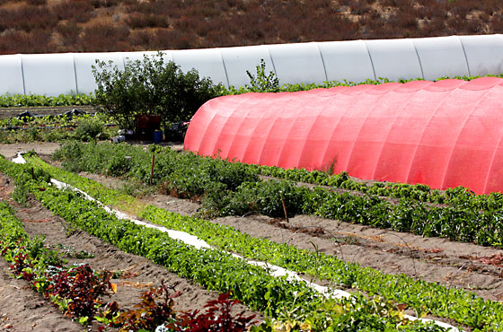
New markets in agriculture: Organics
Farming one of fastest-growing sectors in agriculture
Acres under production grew by 16.5% a year from 2002-2008
Sales account for more than 3% of total food sales
Organic dairy accounts for around 16% of organic sale
Increasing demand for organic foods accompanied by growing “local” movement - organic farmers much likelier to sell products locally
Notes:
Much likelier than commercial to sell locally

Slide 9
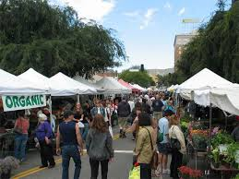
New markets in agriculture: Local
Small farms accounted for 81% of all farms reporting local food sales in 2008
Farming businesses engaged in local foods:
direct-to-consumer marketing farmers’ markets farm-to-school programs community-supported agriculture community gardens | school gardens food hubs & market aggregators kitchen incubators mobile slaughter units urban initiatives
Notes:
Overlap in local and organic markets: 82% of farmers markets had at least one organic vendor

Slide 10
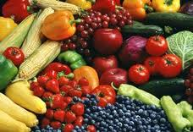
New markets in agriculture: Specialty Crops
Fruits and vegetables, tree nuts, dried fruits, horticulture, and nursery crops including floriculture
Sales of specialty crops total nearly $65 billion per year – critical part of the economy
Non-commodity; more labor intensive
Notes:
High value crops that can be grown on limited acreage

Slide 11
Government Support of Agriculture
Amy Wenner

Slide 12
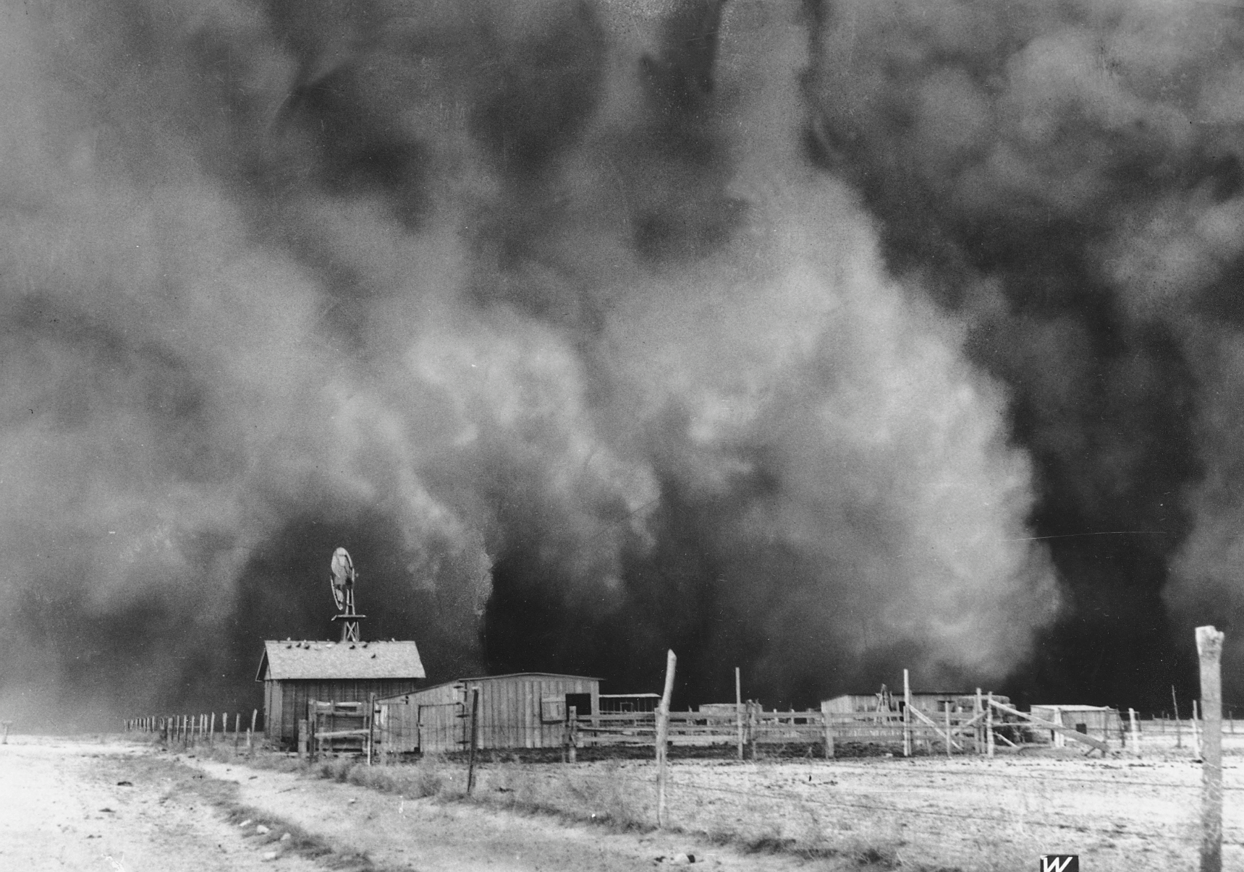
The USDA has provided some form of safety net for farmers since the 1920s to support income, stabilize prices, and ensure food supplies

Slide 13
The Farm Bill
Legislation that determines budget and program content for USDA
Reauthorized by Congress every 5 years
Notes:
Today, most government support is funded through the “farm bill”
The Farm Bill is a massive piece of legislation that guides food and farm policy. It covers wide-ranging topics from rural broadband service to farm subsidy payments.

Slide 14
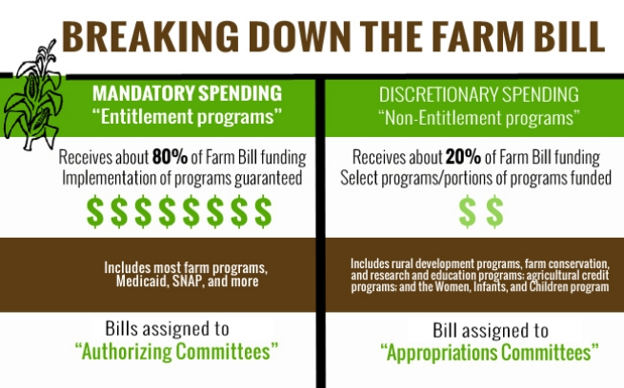
Notes:
The most recent versions of Farm Bill proposals contain 12 distinct titles, or various sections under which Farm Bill supports are organized. They include: commodity, conservation, trade, nutrition, credit, rural development, research, forestry, energy, horticulture, crop insurance, and miscellaneous (yes, its actual title is miscellaneous).
Discretionary funding needs to go through appropriations each year

Slide 16
Ending Direct Payments
Notes:
The 2014 Farm Bill ended the controversial direct payments to farmers of commodity crops, moving to more insurance-based system
SAVINGS OF $4.5 billion annually

Slide 17
Revenue Supports for Commodities
Agricultural Risk Coverage—ARC
Price Loss Coverage—PLC
Protects against falling revenue
Protection down to a 24 percent loss, below which crop insurance activates.
Provides payments when crop prices fall below levels set in the farm bill
New program significantly raises reference price used in the last farm bill
Commodity Crops Eligible for Support
Wheat Oats Barley Corn | Sorghum Long-grain rice Medium-grain rice Pulse crops | Soybeans Other oilseeds Peanuts
Notes:
two new revenue support programs have been included in the new farm bill.
totally separate from the crop insurance programs, which essentially continue unchanged from previous years.
A farmer must choose either PLC or ARC. This choice applies through 2018 and cannot be changed.
The PLC is the default option if the farmer fails to make a choice.
Covered crops unchanged from previous bills

Slide 18
Subsidized Loans for Farmers
USDA helps beginning farmers unable to obtain commercial credit with loans
Farm Bill increases access to credit
Particularly important for farmers just starting their operations

Slide 19
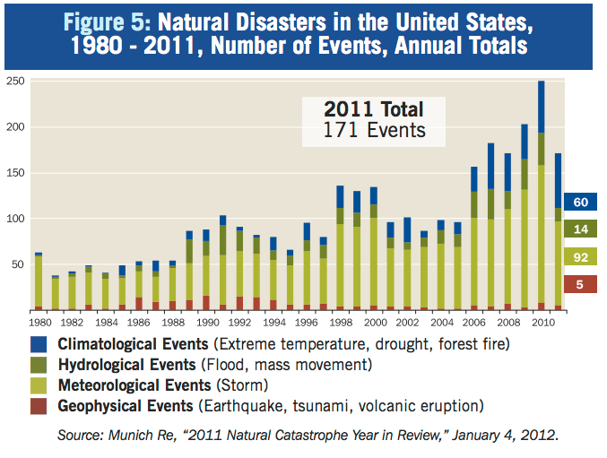
Disaster Assistance
Notes:
USDA’s Farm Service Agency administers disaster assistance programs covering crop loss, livestock loss, and damage to farm property
New farm bill permanently funds livestock disaster programs retroactively to when those provisions ended in 2011.
These programs cover 75 percent of the value of the animals lost

Slide 20
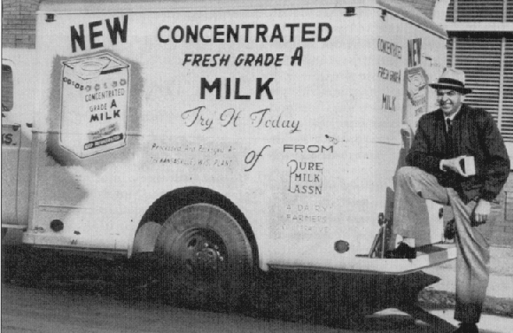
Commodity Dairy Programs
New Farm Bill abandons 70-year-old practice of setting minimum prices for milk, cheese, and butter
Now offering subsidized insurance against falling milk prices or rising feed costs
USDA will buy surpluses when excessive or margins are tight
Notes:
Instead, the bill would offer insurance to dairy farmers to protect themselves against falling milk prices or rising feed costs.
USDA will buy up dairy products and donate them to food assistance programs when milk production is excessive and margins are squeezed.

Slide 21
Organic, Local & Specialty Crops
Farm Bill funding for other areas outside the big 3 -- commodities, nutrition, and conservation -- fairly new phenomenon
$501 million directly into local food, rural development, organic agriculture, and healthy food access initiatives – a 50% increase
New farm bill includes small nationwide program that will ­allow low-income families to double their food stamp benefits at farmers markets
Notes:
starting up in a small way in the 1996 Farm Bill and only hitting its current stride in the 2008 Farm Bill. The renewal of the 2008 funding is significant, as is the advent of permanent spending for the major specialty crop programs and for the Rural Energy for America Program
Investing $501 million over next 5 years
ALSO: To foster exposure to and growth in local foods, USDA has created the Know Your Farmer, Know Your Food management and communications initiative, which helps stakeholders navigate USDA resources and efforts related to local and regional food systems.
USDA promotes and regulates organics through National Organic Program (NOP)to ensure integrity of U.S.-certified organic products

Slide 22
Best Management Practices (BMPs)
Farming methods that assure optimum plant growth and minimize adverse environmental effects
Recommendations can be made at the national level but vary by region
Usually implemented through state agencies and local cities and county boards
Soil Management | Water Use | Water Quality
Minimal soil disturbance Crop diversity Shelter belts | Drip irrigation Field sensors Capture & reuse | Buffer zones Minimize chemical applications Shading & planting changes
Notes:
Minimal soil disturbance (e.g., by no till practices)
crop diversity (crop rotation or incorporating new crops)
Regulation of both water use and water pollution varies by state. No consistent nationwide program addressing agricultural pollution exists.

Slide 23
Research is a cornerstone of economic growth and development. The Federal Government has played a major role in supporting agricultural research for over a century, transforming U.S. agriculture from a resource-based industry to a science-based industry.
Notes:
“Agriculture Research and Development: Public and Private Investments Under Alternative Markets and Institutions,” Economic Research Service, Agriculture Research and Development Report Number (AER-735) 88 pp, May 1996, http://www.ers.usda.gov/publications/aer-agricultural-economic-report/aer735.aspx, accessed 11/18/13.

Slide 24
Food and Agricultural R&D
Public
Private
44% - Basic 47% - Applied 9% - Developmental
High benefit: every public dollar invested generates 10-20 times that amount in benefits to society
Public investments in basic science important in opening new technological opportunities driving private agricultural R&D
19% - Basic 18% - Applied 63% - Developmental
High profit: overwhelmingly intended to develop commercial prototypes, processes, or products
R&D conducted and funded by a small number of large corporations, whose R&D capability tends to dominate certain research areas
Notes:
PUBLIC: Conducted by government agencies, land-grant universities and extension agencies
PRIVATE Conducted by small number of large corporations
Basic: objective is pursuit of new knowledge or ideas without specific applications in mind. insights gained through basic research feed into the development of future innovations and technologies that increase productivity and economic growth over the longer run.
Applied: done to meet a specific need.
Developmental: directed towards the production of specific products and processes with nearer-term commercial potential
Other R&D entities: other federal agencies (both within and outside the USDA); non-profit associations; professional societies; commodity groups and grower associations; multistate research committees; private industry; citizen groups; foundations; regional centers; the military; task forces; and other groups.
Indirect subsidies include agricultural R&D, extension programs, and maintaining agricultural databases.

Slide 25
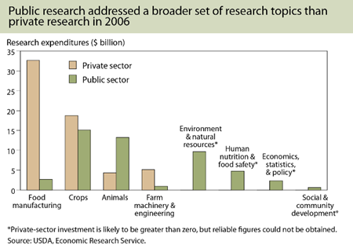
Notes:
Globally, about half or more of all private investment in food and agricultural research and development have been devoted to food manufacturing, not toward input industries and other areas that directly increase agricultural production.
Recent increases in private agricultural input research have mostly centered on crops, including farm machinery and some biofuels investments; livestock-related research and crop protection chemicals have experienced less growth.

Slide 26
R&D: Productivity
Gains in efficiency have defined American agriculture. Public & private investments in R&D have helped farmers find ways to grow more with less.
Slowdown in public & private R&D spending on productivity enhancement – may slow down overall agricultural productivity
Example: In 1950, the average dairy cow produced about 5,300 pounds of milk, today, 22,000 pounds
Improvements in cow genetics, feed formula, and management practices
Number of dairy cows in America fallen by more than half, yet milk production has nearly doubled

Slide 27
R&D: Organics & Local Agriculture
USDA spent $117 million between 2009 and 2011 in R&D focused on improving the productivity and success of organic agriculture
Example: USDA research on weak management of organic vegetable production produced techniques and tools that can help control 7 percent of weeds at 15 percent of the previous cost for weed control
Spreading findings to those in the field is critical, and “eOrganic” electronic extension service funded by the USDA has become an essential tool for compiling and disseminating knowledge about organic production.

Slide 28
R&D: New Technologies
Nanotechnology
1600 commercially available products, including: stain repellent in clothing, material to extract toxics from water, sunscreens to absorb light, and a barrier in packaging such as beer bottles
Future uses in ag production: precision field sensors, smart delivery systems, water filtration.
Food industry: nanosensors in food packaging
Agriculture Equipment: more efficient planting, fuel use, less erosion
Light Resources: artificial light usage in greenhouses & vertical farming
Biofactories: manufactured chemicals with same properties as natural
Energy Resources: solar, wind, biofuel, anaerobic manure digesters
Satellite, GPS and Computers: monitoring irrigation, tracking nutrients, forecasting weather, predicting yields
Notes:
Technology: helps increase yields using fewer inputs/resources
Nanotechnologies: questions as to safety and potential toxicity from these products need to be addressed as soon as possible. risks include the ability of the particles to cross the blood-brain, dermal, placental and other barriers, potential impacts on biological systems and control and tracking of the particles
Questions about whether risk assessments are being completed, if they are sufficient and unbiased

Slide 29
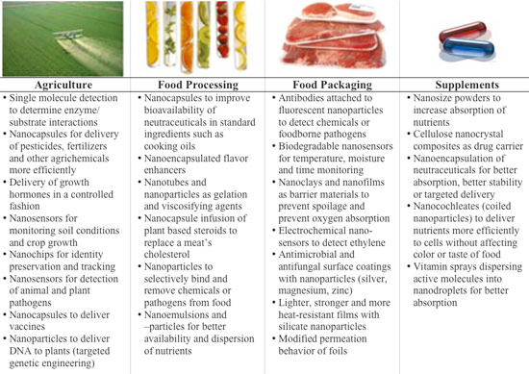
Food Nanotechnology
Notes:
Here is an overview of what nanotechnology applications are currently being researched, tested and in some cases already applied in food technology: Read more: Nanotechnology in Food http://www.nanowerk.com/nanotechnology-in-food.php#ixzz2vpkH2zON

Slide 30
Crop Insurance

Slide 31
Crop Insurance
Mary Trippler

Slide 32
Crop insurance
Voluntary contract between a farmer and an insurance carrier to protect against catastrophic loss inherent in farming
It works as a safety net for farmers facing problems of drought, ﬂoods, pests as well as price volatility
In 2013 there were more than 2.2 million crop insurance policies sold, covering more than 300 million acres of farm land

Slide 33
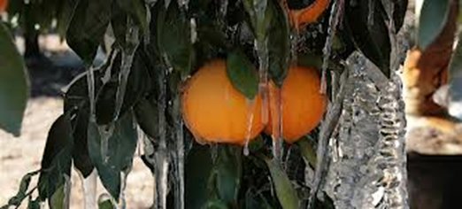
How crop insurance differs from subsidies
Subsidies are direct payments to farmers
Crop insurance is purchased by farmers from approved insurance providers to protect themselves from loss of crops or loss of revenue
Crop insurance is now the primary agricultural safety net under the 2014 Farm Bill

Slide 34
Types of crop insurance coverage
Crop yield insurance
Hail and other spot coverage insurance purchased from private insurer with no federal premium subsidy (private products)
Multi Peril Crop Insurance (MPCI) federally-subsidized coverage for hail, ﬂood, drought, insects, and bacteria
Crop revenue insurance
Protects estimated farm revenue from price declines in single season
2014 Farm Bill creates additional premium subsidy programs for particular crops (e.g., hemp and cotton) and particular losses

Slide 35
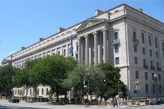
Federally subsidized crop insurance
Oﬀers broad coverage for separate, tailored policies for more than 100 commodities, including organics
15 diﬀerent plans based on farmer's individual historic production, county area averages or farmer's tax information
Some plans oﬀer yield only coverage, some yield and revenue, and some use set dollar amount of insurance
Farmers often buy both private and federally subsidized plans as part of risk management
Notes:
Administered by 18 companies that are paid $1.4 billion annually by the government to sell policies to farmers, and pays 62% of farmers’ premiums. (Mary-delete if you don’t need)

Slide 36
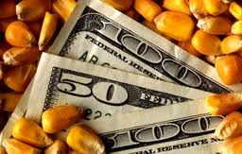
How subsidies work
Farmers agree to insure all eligible acreage in a particular county
In return, the government subsidizes the cost of insurance premiums up to two-thirds of the cost by payments to the insurance company
For example, if the per acre premium for MPCI is $60, the farmers pays $22-24 per acre with the government paying the remainder
Without the subsidy, the risk is too great for the insurance provider
Funding for subsidies in 2014 Farm Bill
Estimated costs over 10 years is approximately $89.8 billion

Slide 37
Limits/caps on subsidies
No limit on premium subsidies under 2014 Farm Bill
Skewed to larger/wealthier farmers and producers
In 2011, mean annual crop insurance subsidy for top 1% of policy holders was $227,000
During the same year, the mean annual crop insurance subsidy for bottom 80% of policy holders was $5,000
2014 Farm Bill also limits the USDA's ability to negotiate new premium schedules by creating a ﬂoor for the cost of a standard reinsurance agreement

Slide 38
Links between premium subsidies and conservation practices
2014 Farm Bill requires compliance with USDA's Conservation Reserve Program (CRP) to fully qualify for premium subsidies
CRP removes sensitive land from agricultural production
Goal is to re-establish land cover, improve water quality, prevent erosion, preserve wildlife habitat
Includes a Sodsaver program to protect natural prairies
Minnesota now has approximately 1.3 million acres in CRP (total farmland - 27 million acres)
Beneﬁts farmers through premium subsidies
Attractiveness of program depends on crop prices, i.e., higher prices means fewer CRP acres
Notes:
Conservation funding DECREASED by $4 billion over 10 years

Slide 39
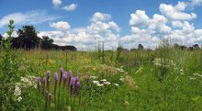
2014 Farm Bill: cuts funding and limits acreage
$6 billion cuts to CRP over 10 years
Maximum enrolled acreage reduced by 8 million acres (equivalent to 22% of State of Iowa)
Eﬀect is fewer sensitive acres removed from production, less native prairie and wildlife habitat

Slide 40
Anti-Trust Enforcement in Agriculture
Mary Trippler

Slide 41
Responsible federal agencies
Antitrust law is based on the notion that competitive market forces should play a primary role in determining the structure and functioning of the market
Two federal agencies are charged with curbing speciﬁc private sector conduct from interfering with market forces
U.S. Department of Justice (DOJ) Antitrust Division covers the producing and processing agricultural sectors
Federal Trade Commission (FTC) of the U.S. Department of Commerce covers the retail sector, including groceries

Slide 42
Types of antitrust violations
Monopoly in which companies through increase in size or scale of production, by consolidation or by other restrictive conduct, control market or portion thereof to lessen competition
Collusion in which separate entities agree among themselves not to compete (i.e., price ﬁxing, bid rigging, allocation of markets)
Anti-competitive merger in which ﬁrms merge or are acquired in a manner which lessens competition
In the agricultural sector, antitrust violations often concern seed and fertilizer supply, commodity pricing and marketing, processing and retail grocery sales which injure farmers, smaller processors and retails as well as consumers

Slide 43
Limits on antitrust enforcement
DOJ has no power to restructure an industry, market or company, or to stop and practices, except by setting forth speciﬁc violations which can be proved in enforcement actions in court
The federal courts decide whether the facts and law support the claims of antitrust violation

Slide 44
Violations are diﬃcult to prove
To prove monopoly, DOJ must present particular facts showing that the company at issue stands a "dangerous probability" of acquiring a monopoly as a result of restrictive conduct
Having a monopoly is not necessarily illegal if acquired legally, that is, without restrictive conduct
There is no formula for what market share constitutes a monopoly; sometimes a 60% market share is suﬃcient but, in other cases, a larger market share is not enough
Collusion requires proof of willful subversion of normal operation of markets
Anti-competitive merger is a prospective analysis, that is, is it likely that the merger would substantially lessen competition for a particular product or in a geographic market

Slide 45
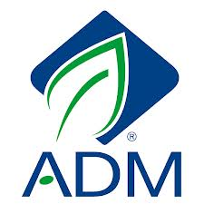
Examples of antitrust violations in agriculture: Collusion
In 1996, DOJ prosecuted Archer Daniels Midland (ADM) and others for participating in a cartel to suppress competition for lysine, a feed additive for livestock and poultry
During the conspiracy, the cartel inﬂated the price of lysine by tens of millions of dollars
ADM paid a criminal ﬁne of $100 million and three executives were sentenced to prison terms

Slide 46
Examples of antitrust violations in agriculture: Anti-competitive merger
in 1998, Monsanto proposed acquiring Dekalb Genetics Corporation which, like Monsanto, was a leader in corn seed biotechnology and both held patents giving them control over technology
Concern was how the merger would eﬀect both competition of seed and biotechnology innovation
Merger was allowed when Monsanto agreed to spin oﬀ certain technologies and to license certain corn germination technology to over 150 seed companies to allow then to develop there own corn hybrids
No changes to antitrust statutes in the 2014 Farm Bill

Slide 47
CONSENSUS QUESTIONS

Slide 48
Economic Health of the Agricultural Sector
Should government financial support for agriculture be directed to:
Subsidized agricultural credit (loans)
______ Yes
______ No
______ No Consensus
b) Disaster assistance ______ Yes
______ No
______ No Consensus
c) Crop insurance ______ Yes
______ No
______ No Consensus
d) Farms that supply local and regional markets ______ Yes
______ No
______ No Consensus
e) Subsidized implementation of best management practices ______ Yes
______ No
______ No Consensus
f) Commodity crop programs, e.g., corn, soybeans, sugar, cotton, wheat ______ Yes
______ No
______ No Consensus

Slide 49
Economic Health of the Agricultural Sector
Should government financial support for agriculture be directed to:
g) Commodity livestock program ______ Yes
______ No
______ No Consensus
h) Commodity dairy program ______ Yes
______ No
______ No Consensus
i) Specialty crops, e.g. fruits, vegetables, nuts, etc. ______ Yes
______ No
______ No Consensus
j) Other production methods, e.g. organic, hydroponic, urban, etc. farms
______ Yes
______ No
______ No Consensus
Comments:

Slide 50
Economic Health of the Agricultural Sector
2. What changes should government make regarding direct payment programs to farm operators? Note: Farm operators can be anything between family farms to huge corporations.
a) Eliminate direct payments to farm operators ______ Yes
______ No
______ No Consensus
b) Update the rules for direct payments to farm operators to support sustainability ______ Yes
______ No
______ No Consensus
c) Broaden the types of farms that are eligible ______ Yes
______ No
______ No Consensus
d) Broaden the types of crops that are eligible
______ Yes
______ No
______ No Consensus
e) Broaden the types of crops that are eligible
______ Yes
______ No
______ No Consensus
Comments:

Slide 51
Economic Health of the Agricultural Sector
3. What changes to current crop insurance programs should government make?
Note: Farm operators can be anything between family farms to huge corporations.
a) Extend to more types of crops ______ Yes
______ No
______ No Consensus
b) Link to the use of conservation practices ______ Yes
______ No
______ No Consensus
c) Limit insurance for the cultivation of marginal and environmentally sensitive land ______ Yes
______ No
______ No Consensus
d) Cap amount of premium subsidy to a single farm operator (see note) ______ Yes
______ No
______ No Consensus
Comments:

Slide 52
Economic Health of the Agricultural Sector
4. Should government act on any of the following?
a) Revise anti-trust legislation to ensure competitive agricultural markets ______ Yes
______ No
______ No Consensus
b) Enforce anti-trust laws as they relate to agriculture ______ Yes
______ No
______ No Consensus
c) Promote alternative marketing systems, including regional hub markets, farmer cooperatives, farm markets, etc. ______ Yes
______ No
______ No Consensus
Comments:

Slide 53
Research and Development
7. Which of the following approaches to research and development (R&D) should government fund or accomplish? Note: For the purpose of these questions and some questions below, “developed using any new technology” or “new technologies” refer to any of many scientific processes for developing new crops or animals with genetic engineering, nanotechnology or other new techniques, which are not the traditional breeding or hybridization techniques.
Basic research
______ Yes
______ No
______ No Consensus
b) Independent third-party (such as an academic institution) risk assessment of products developed using any new technology ______ Yes
______ No
______ No Consensus
c) Research to assess the impacts of new technologies on human health and the environment, prior to their widespread adoption ______ Yes
______ No
______ No Consensus
d) Research that advances the continuation of diversified and sustainable agricultural systems ______ Yes
______ No
______ No Consensus

Slide 54
Research and Development
7. Which of the following approaches to research and development (R&D) should government fund or accomplish? Note: For the purpose of these questions and some questions below, “developed using any new technology” or “new technologies” refer to any of many scientific processes for developing new crops or animals with genetic engineering, nanotechnology or other new techniques, which are not the traditional breeding or hybridization techniques.
e) Seed banking, research, and other means that promote and preserve genetic diversity
______ Yes
______ No
______ No Consensus
f) Both transparency in the reporting of research studies related to approval of new products and respect for intellectual property rights of private enterprises engaged in research ______ Yes
______ No
______ No Consensus
g) Research on long-term effects of new crops, products and processes ______ Yes
______ No
______ No Consensus
h) Development of new practices and technologies to promote conservation for all types of farms ______ Yes
______ No
______ No Consensus
Comments:

