Slide 1
Agricultural Study
March 13, 2014
Ag Study Committee
Mary Theresa Downing
Sue Hnastchenko
Cathy Rude
Mary Trippler
Amy Wenner
LEAGUE OF WOMEN VOTERS® of SOUTH TONKA
Serving Deephaven, Excelsior, Greenwood, Shorewood, Tonka Bay, Woodland

Slide 2
Consensus Process
Consensus is mutual agreement of League members arrived at through discussion.
Each local League chapter discusses the pros and cons until it becomes apparent that consensus has/has not been reached on each question.
Each League reports its consensus (or lack of), and based on this information, the national study committee formulates the position.
Once the position is approved by the Board it can be used for action.

Slide 3
Current LWV Agriculture Policies
National position last updated in 1988; believes that federal agriculture policies should promote:
adequate supplies of food and fiber at reasonable prices to consumers,
farms that are economically viable,
farm practices that are environmentally sound, and
increased reliance on the free market to determine prices.
Minnesota position in Program for Action: 2011-2013; supports:
System of sustainable agricultural production which:
provides safe, healthful food,
preserves and protects the state’s human and natural agricultural resources, and
enhances the environment;
Research and technical assistance in farming practices and rural economies that improve:
the economic viability of family farms,
environmental health, and
the quality of life of family farmers and their communities.
Notes:
More specifics of the positions are presented in each section where applicable.

Slide 4
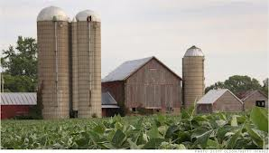
Scope of Agriculture Study
Current technology issues in agriculture
Genetically modified organisms (GMOs)
Herbicides & pesticides
Agricultural water pollution & technology
Antibiotics in livestock
Accurate food labeling
Current agriculture finance issues
Consolidation in agriculture industries
Crop subsidies
Federal agricultural regulatory process

Slide 5
National Spending on Agriculture: 4%

Slide 6
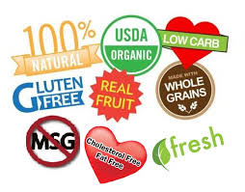
Agencies and Food Labeling: USDA & FDA
Sue Hnastchenko
Notes:
6

Slide 7
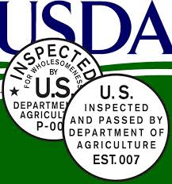
United States Department of Agriculture (USDA) Role in Food Labeling
Inspections and quality standards for meat & poultry & eggs
Meat & poultry labels require pre-approval
About 60,000 labels per year

Slide 8
1962 - Consumer Bill of Rights 1990 - Nutrition Labeling and Education Act 1994 - Easy to read/understand nutrition labels required on meat/poultry 1997 - FDA Modernization Act – regulation of health claims 2004 - Food Allergy Labeling & Consumer Protection Act 2013 - Food Labeling Modernization Act – grant FDA additional authority in labeling 2013 - GE Food Right to Know Acts - failed in committee
USDA Legislative History

Slide 9
Food & Drug Administration (FDA) Missions for Agriculture
Food Safety Missions:
Food additives
Biotechnology
Food labeling
Production of educational materials
Veterinary Missions:
Ensure safety of animal drugs, feeds & regulation of genetically engineered animals
Designs regulations and enforces them them through reports, inspection & investigation

Slide 10
1954 - FDA role in monitoring pesticide residues 1958 - 60 - Definitions & rules concerning food and color additives 1980 - Labeling & post-market monitoring of infant formula 1990 - Nutrition labeling & education 2004 - Food allergen labeling & consumer protection 2011 - Food Safety Modernization Act
Noteworthy Laws Affecting the FDA

Slide 11
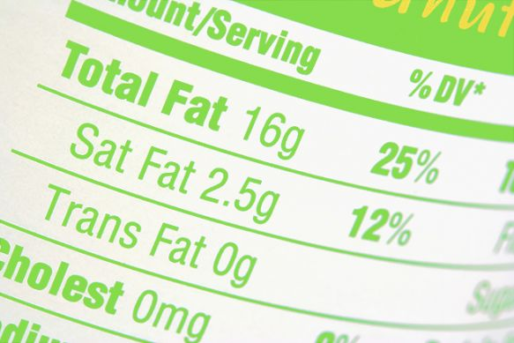
FDA Role in Food Labeling
Safety of domestically consumed foods produced both domestically & internationally
Standard nutrition labeling system (excludes meat and poultry)
Requirements & guidance for mandated food label attributes
Nature of Guidelines:
Provide instructions to FDA personnel and community on law compliance
Voluntary, not legally binding
Regulatory flexibility allows alternative approaches

Slide 12
FDA Current Issues & Challenges
Issues
GRAS ("generally recognized as safe") substances
Genetically engineered foods & animal feed
New additives require premarket testing & approval
Challenges
Human resource & budgetary constraints
FDA's oversight/enforcement efforts not kept pace with number of food firms
Growth in food imports
Lack of well-trained scientists and inability to keep up with scientific advances
Information technology systems obsolete & unreliable

Slide 13
FDA/Consumer/Industry Label Conflict
Consumer Groups:
Cleaner, less confusing labeling system
Consumers' right to know
Center for Science in the Public Interest seeking better rulemaking and enforcement by FDA on misleading food labels
Pictures on label often misrepresent, despite fact the ingredient label is accurate
30 states with movements to put mandatory labeling of GE food to vote of the people
Industry Groups:
Labeling can unfairly stigmatize a food
Farmers, producers, retailers unfairly incur additional costs
Additional costs passed on to consumers
Notes:
13

Slide 14
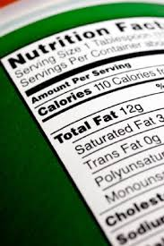
Food Labels Must Include:
Name of product
Ingredient list
Nutritional information
Net quantity
Allergy information
Contact information (manufacturer, packer, and/or distributor)
Notes:
14

Slide 15
Mandatory Nutrition and Health Labeling
Nutrition Facts – Mandatory
Allergy and Gluten Labeling – Mandatory
8 known food allergens responsible for 90% of food allergies
Gluten allergies/sensitivities affect 1 in 133 individuals
Qualified Health Claims - FDA Investigated & added qualifying language to characterize strength/limitations of scientific evidence
Producers identify relationship between substance and the disease to justify claim; and
The health claim (benefit); and
Scientific evidence that supports the claim
2002-2010, 16 petitions for 60 claims, only 12 claims approved
Notes:
15

Slide 16
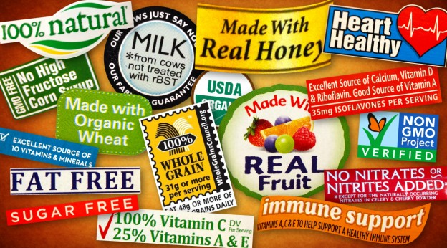
Nutrition and Health Label CLAIMS
Structure/Function Claims
Relationship between substance and bodily structure/function
Not pre-reviewed or authorized by FDA
Burden of proof that product doesn't meet claim rests on FDA
Nutrient Content Claims
May be based on authoritative statement from scientific body of government or National Academy of Sciences
A generalized level of a nutrient in a food : "free," "high," and "low”

Slide 17
Nutrition & Health Community Concerns
Food choices & consumption quantity key factors in public health
Educating public on choices/reducing confusion on food labels integral to America's health and economy
Consumer difficulty distinguishing difference between many different types of claims: health vs. qualified health vs. structure/function
Notes:
17

Slide 18
Sensory & Image Advertising
Sensory Branding: Marketing that appeals to all the senses in relation to the brand. It uses the senses to relate with customers on an emotional level

Slide 19
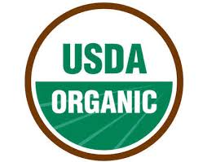
Food Labeling: FDA & USDA
Organic
USDA sole authority for certification, accreditation, compliance, enforcement
Production methods that integrate cultural, biological, mechanical practices
Synthetic fertilizers, sewage sludge, irradiation, GE not allowed
Required for $5,000+ annual organic sales
Irradiation
Improves food safety and extends shelf life by reducing or eliminating microorganisms and insects
FDA, WHO, CDC, USDA endorsed safety
International food irradiation symbol, and statement "Treated with/by radiation" required
Notes:
19

Slide 20
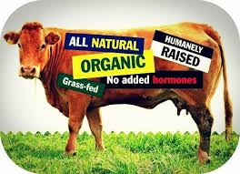
Meat & Poultry Labeling Terms
Cage Free - USDA guidelines defined
Certified – USDA inspected
Chemical Free – Not allowed
Free Range – USDA regulated
Grass-Fed – USDA regulated
Humane – Not regulated/defined
Mechanically Sep. Meat – Pork only
Mech. Sep. Poultry – Use without restriction, must be labeled
Natural – USDA regulated
Minimally processed & no artificial ingredients
No standards for products w/o meat or eggs
No Hormones
Beef - approved with sufficient documentation
Pork/poultry/goat – not allowed
No Antibiotics – Approved with sufficient documentation
Pasture-raised – No USDA definition
Country of Origin (COOL): labeling law requiring source of food

Slide 21
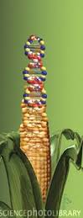
Bioengineered Foods (GMO/GE) Label Guidelines
If significantly different from traditional counterpart so the common name no longer describes the new food, the name must be changed to describe the difference
If an issue exists for the food in regards to a consequence from its use, the consequence must be described
Significantly different nutritional properties must be stated
If contains allergen consumers would not expect based on name of food, allergen must be disclosed
Threshold level of one percent GE content recommended
Labeling voluntary, provided product not significantly different from its traditional counterpart
Notes:
21

Slide 22
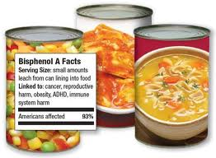
FDA Voluntary Guidelines for GE/GMO Labels
GMO Free – FDA does not recommend, free implies zero
Genetically Modified – FDA inappropriate, all crops have been modified
Biotechnology not used to produce ingredient – FDA ok
Product made from “x” not genetically engineered – FDA ok
“x” not genetically engineered – FDA views as misleading
Genetically engineered – FDA ok
Product contains “x” that was produced using biotechnology – FDA ok
Product contains high oleic acid soybean using biotechnology to decrease saturated fats – FDA ok – underline mandatory = nutrition change

Slide 23
GMO Label Concerns:
Labels already too busy
60-70% of items in grocers already contain GE ingredients
Buying Habits
Risk Assessment
Concept of Process v. Product
Transparency

Slide 24
Nanotechnology & Modern Agriculture
Process that builds, controls and restructures materials that are the size of atoms and molecules
A nanometer is one-billionth of a meter
Possible uses in food packaging:
to detect spoilage or act as a preservative
to control release of color or nutrients in foods to consumer preferences (already utilized to prevent caking of powders)
Rapid expansion of research and development of new uses, questions as to safety and potential toxicity
EPA is in process of developing rules and guidance

Slide 25
Technology Advances & Food Production
Light Resources
Greenhouse & vertical farming techniques using artificial light
Controlled environment eliminates many disease, insects, weeds, yet impact on nutritional quality unknown
Biofactories
Biotech companies create new organisms that can be programmed with the capacity to manufacture chemicals that exactly duplicate ones that are now extracted from plant sources
Use GE yeast that can convert sugar to medicine, create biofuels and & other products

Slide 26
BREAK

Slide 27
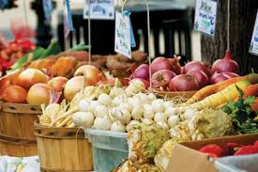
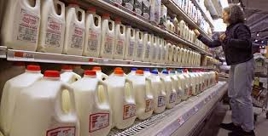
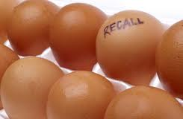
Food Safety
Mary Theresa Downing

Slide 28
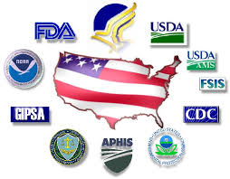
Interaction of Food Safety Agencies
15 agencies and 30 laws cover food safety.
Division of responsibilities among agencies, agency differences in approach to inspection and enforcement, inadequate funding affect efficacy.
GAO studies over past decade have found fragmentation, ineffective coordination and inefficient use of resources.
In 2007 GAO put food safety oversight on high-risk list, saying government-wide, results oriented performance plan with cross-agency perspective needed.
Former President's Council on Food Safety disbanded after 3 years with no plan.
Food Safety Working Group (2009-present) plan generally lacks results-oriented goals and performance measures as well as information about resources.

Slide 29
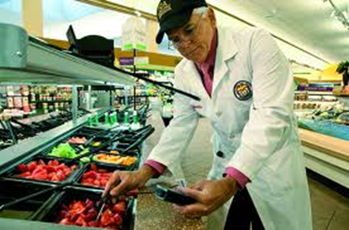
MAJOR FOOD SAFETY AGENCIES
USDA (United States Department of Agriculture)
Inspects every piece of meat, also poultry and eggs.
FDA (Food and Drug Administration)
Spot inspects; responsible for 80% of food, including dairy, plant products, seafood, grain-based foods and bottled water.
Food Safety Modernization Act (FSMA) calls for prevention as well as response to food contamination.
CDC (Centers for Disease Control)
Estimates and tracks food-borne illness, resulting hospitalizations and deaths.

Slide 30
National Institute of Environmental Health Science
Part of NIH; does medical research; current priorities include:
Endocrine disruptors
BPA – used in plastic bottles and to line tin cans
Phthalates – inert ingredient in many agricultural pesticides
Arsenic – used to promote growth in chickens; now banned
Pesticides, herbicides and fungicides
Nanomaterials – still unknown risk
Environmental Mixtures (Complex, Chronic Exposures)
better models of real-life exposures needed; this research now a top priority

Slide 31
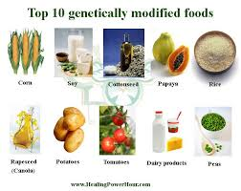
Regulation of GE Products
Safety and regulation of GE food and feeds under FDA
USDA Animal and Plant Health Inspection Service (APHIS) regulates importation, interstate movement, and environmental release of transgenic plants to protect existing crops from hazards and assure that GM plants and animals are safe to produce.
EPA registers pesticide products in transgenic plants prior to their distribution and sale and establishes pesticide tolerances for residues in foods.

Slide 32
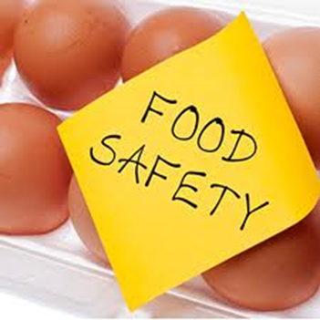
Current Approval Process for GM Products
APHIS receives notification that company plans to field test GM product.
In 30 days APHIS staff decides whether sufficient information to allow testing; no public or outside scientific input.
If insufficient information, product must go through more rigorous permitting process, including publication of description of application in Federal Register and public comment; currently not commonly used.
Deregulation - data and analyses provided by manufacturer; GM seed not made available for independent research until product approved for marketing. Process not transparent: manufacturers claim releasing applications would expose confidential business information (CBI). But regulatory agencies in other countries receive applications with less CBI - applications can be made public.
Post-deregulation - no further oversight of plants submitted or their descendants.
National Regulatory Commission (NRC) argues for validation testing and ecological monitoring after commercialization.

Slide 33
GMO Testing: Views & Findings
Critics – voluntary, testing done by applicants not agencies, responsibility for safety depends on developers.
Developers – actually mandatory, rigorous, highly prescribed, time consuming, expensive.
Study found both right.
Regulatory agencies of many countries and organizations agree – no evidence of danger in eating GMO foods.
Nature and Scientific American agree.
But 97 scientists say no consensus:
Epidemiologists can't study link between GMOs and adverse effects – no one knows if they're eating GMOs since no labels.
Weaknesses in studies, flaws in assessment protocols; gaps in understanding how genetic expression turned off and on.
Need to assess risk of complex exposures: GE food, animal antibiotics and hormones, pesticide residue, nanomaterials and novel food processor materials, among other factors.

Slide 34
LEAGUE POSITIONS – Food Safety
U.S.:
Supports actions to reduce the use of toxic chemicals on the farm.
In 1988-1991, the LWVEF worked with Public Voice for Food and Health Policy and state and local Leagues on a citizen education project on agricultural issues, including pesticide residues in food and water, sustainable agriculture, and research and technology.
Minnesota:
Research into genetically modified foods is supported if the purpose of such research is to ensure the long-term safety of GMO food and crops, to advance the basic research knowledge, to benefit sustainable agricultural practices and to serve the public good.

Slide 35
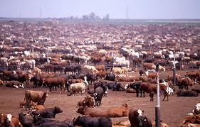
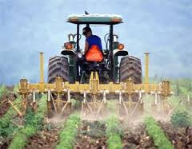
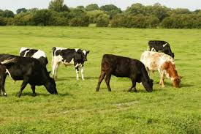
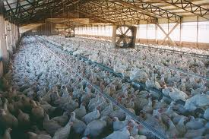
Farm & Animal Management
Cathy Rude

Slide 36
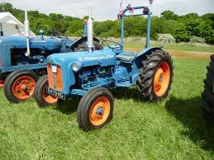
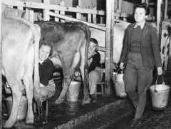
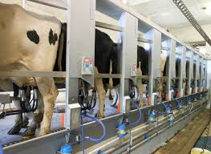
Farm Management
Early 1900’s Farming vs. Farming Today
Today’s Benefits:
Steady supply of inexpensive food
better financial performance,
higher rates of return on equity
decreased in use of resources
Today’s Challenges:
environmental issues
cost to human health
Strain on small towns
Greater reliance on chemicals: fertilizers and pesticides

Slide 37
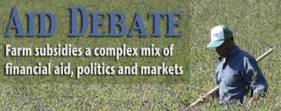
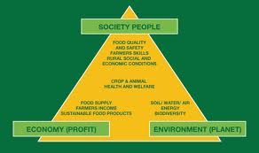
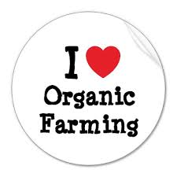
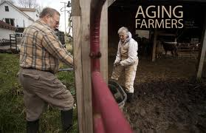
Farm Management Trends
Subsides and Crop Insurance
Contract Farming
Sustainable Farming
Organic Farming
Aging Farmers

Slide 38
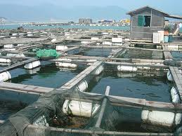
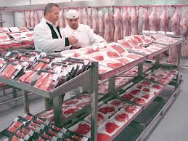
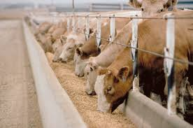
Animal Management: Trends
Aquaculture operations
Growth, concentration and increased scale of farms
Animal Feed Operations (AFO- 450,000 in US)
Concentrated Animal Feeding Operations
(CAFOs-15% of 450,000 are designated as CAFOs)
aquaculture operations
The movement of meat processing from urban centers to rural areas.
Technology
Notes:
Example: In 1950, the average dairy cow produced about 5,300 pounds of milk. Today the average cow produces about 22,000 pounds of milk, thanks to improvements in milking tech., advances in nutrition & health, breeding, and management practices.

Slide 39
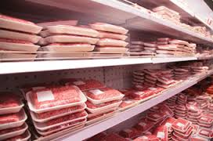
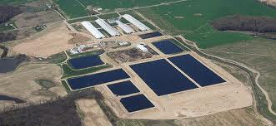
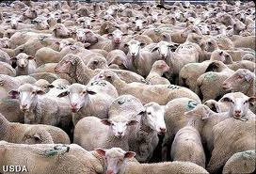
Animal Management
Benefits:
Inexpensive, readily available meat and dairy
Improved technology, research, refrigeration, and transportation
Advances in nutrition, health and management of animals- (cutting costs)
Increased production with less time, equipment, and labor
Export more globally
Better financial performance and higher rates of return on equity
Challenges:
Domination of a few large corporations
Lack of transparency and ability to regulate
Overcrowding/disease, poor animal health & welfare
Overuse of antibiotics
Water/air pollution
Death of small towns

Slide 40
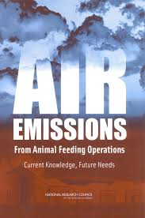
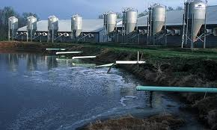
Animal Management: Impact on Environment
Major sources of runoff water contamination & air pollution
Concerns:
Regulations, monitoring and enforcement weak
Lack of coordination with multiple agencies:
differing local and state regulations
LWVUS-recommends federal oversight and standards
Right to Farm Law
Notes:
CAFOs are potentially subject to regulation under the Clean Air Act (CAA), but the emissions from CAFOs generally do not exceed established statutory thresholds.^{[108]} In addition, the EPA's regulations do not provide a clear methodology for measuring emissions from CAFOs, which has "vexed both regulators and the industry.“
The EPA's authority to regulate CAFO waste that results in agricultural stormwater discharge was one of the "most controversial" aspects of the 2003 rule.^{[78]} The issue centered on the scope of the Clean Water Act (CWA), which provides for the regulation only of "point sources." The term was defined by the CWA to expressly includeCAFOs but exclude "agricultural stormwater.

Slide 41
Reviews and monitors
Has the right to prosecute
Legislation Related to Agriculture
Clean Water Act (CWA) - Water runoff issues
Federal Insecticide, Fungicide and Rodenticide Act (FIFRA)

Slide 42
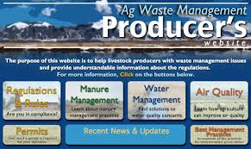
Animal Waste Regulation
Historically, very little legislation.
Much complexity and turmoil in regulations:
2000’s EPA tries to set regulations, monitoring and requirement for permits. (Loopholes, lawsuits and constant changes)
2011: EPA requirements for CAFOs to submit info on location, size, type of animals, treatment, size of land, etc..
2012: Regulations withdrawn due to CAFOs opposition
2013: Lawsuits from environmental groups.
Local and state regulations vary greatly
* LWVUS position: EPA Federal Government should set and enforce standards.
Notes:
http://www.sustainabletable.org/906/waste-management

Slide 43
New Technologies in Animal Waste Treatment
Goal: reduce harmful E. Coli bacteria
Add sodium carbonate to manure
Add seaweed to feed
Send cattle out to graze reducing feed of corn/grains
*Research shown to decrease E. Coli in all three options.
Bottom Line:
Large # of cattle Large amount of waste= environmental concerns
Notes:
http://www.sustainabletable.org/906/waste-management

Slide 44
Animal Management: Antibiotics
Most animals receive pharmaceuticals in feed for disease prevention whether they need it or not.
Use and Benefit:
Prevent, control and treat disease in animals.
Make food supply safer and people healthier
Concerns:
Overuse and link to antibiotic resistant bacteria
Difficult for FDA to monitor use and resistance trends.
No legal power over use or resources to withdraw antibiotics already approved for market.

Slide 45
Animal Management: Antibiotics
FDA approval evaluation process:
Safety to the animal and food products made from the treated animal;
Effectiveness;
Impact on the environment; and
Safety of the people administering the drug or who may come into contact with the drug.
Wait period
Recommendation to FDA by concerned watch groups:
Phase out use of antibiotics in livestock except for treatment of sick animals.

Slide 46
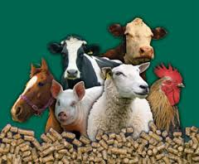
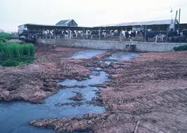
Animal Management: Subsidies
Subsidies for feed (decreases production expenses $3.9 billon/year)
Benefited CAFOs vs. small farmer
Environment Incentives
CAFOs receive a more direct subsidy through Environmental Quality Incentives Program (EQIP) funding.
History:
1996 Farm Bill, EQIP originally targeted small and mid-size farms.
2002, expanded funding to large-scale waste management systems.
Recommendations: (The National Sustainable Farm Associations)
Greater transparency of funding
Assess impact /benefit of funding
Restriction of EQIP funds to mitigation of existing environmental challenges, rather than financing waste management operations of new or expanding CAFOs.

Slide 47
LEAGUE POSITIONS – Animal Management
Minnesota:
Supports stricter standards for animal confinement operations (based on concerns for both animals and human health as well as ethical issues relating to the treatment of animals)

Slide 48
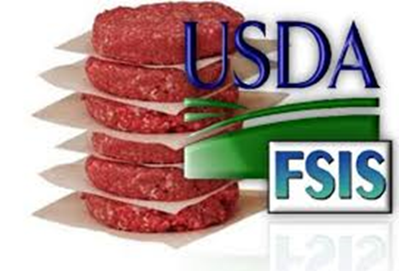
Meat Safety
Antibiotics, other anti-infection medications given to animals in crowded conditions to prevent sickness; produces antibiotic-resistant bacteria and viruses.
GE animals not approved or released for human food.
FDA considers recombinant DNA a drug, all right if:
safe to animal
safe to consumers of animal
safe for environment
effective as claimed.
Public concerned about transparency of guidelines
lack of labeling
lack of agency oversight with regard to environmental impact

Slide 49
CONSENSUS QUESTIONS

Slide 50
Food Labeling
9. How sufficient are the following regarding current food labeling?
Nutrition Facts on food labels
______ Insufficient
______ Sufficient
______ Too much
______ No Consensus
b) Nutrition Facts on food labels as a means of consumer education
______ Insufficient
______ Sufficient
______ Too much
______ No Consensus

Slide 51
Food Labeling
9. How sufficient are the following regarding current food labeling?
c) Common allergen labeling
______ Insufficient
______ Sufficient
______ Too much
______ No Consensus
d) Health and ingredient claims that consumers can understand
______ Insufficient
______ Sufficient
______ Too much
______ No Consensus
Comments:

Slide 52
Food Labeling
10. Which of the following should government achieve regarding marketing and ingredient claims on food labels?
Define (and approve for use) health and safety marketing terms (e.g. immunity support, humane, pasture-raised, natural, etc.)
______ Yes
______ No
______ No Consensus
Regulate the use of images or other sensory advertising
______ Yes
______ No
______ No Consensus

Slide 53
Food Labeling
10. Which of the following should government achieve regarding marketing and ingredient claims on food labels?
Require that ingredient marketing claims accurately represent what is in the required ingredient list
______ Yes
______ No
______ No Consensus
Comments:

Slide 54
Food Labeling
11. Recognizing that each food developed using any new technology can be unique, and assuming that required food labeling should be useful to consumers, should the following generalized information relating to how products or components are developed be presented on food labels?
Note: For the purpose of these questions and some questions below, “developed using any new technology” or “new technologies” refer to any of many scientific processes for developing new crops or animals with genetic engineering, nanotechnology or other new techniques, which are not the traditional breeding or hybridization techniques.
Contains ingredients developed using any new technology stating which technologies are involved
______Not Recommended
______Voluntary
______Mandatory
______No consensus
b) Does not contain ingredients developed using any new technology
______Not Recommended
______Voluntary
______Mandatory
______No consensus

Slide 55
Food Labeling
11. Recognizing that each food developed using any new technology can be unique, and assuming that required food labeling should be useful to consumers, should the following generalized information relating to how products or components are developed be presented on food labels?
Note: For the purpose of these questions and some questions below, “developed using any new technology” or “new technologies” refer to any of many scientific processes for developing new crops or animals with genetic engineering, nanotechnology or other new techniques, which are not the traditional breeding or hybridization techniques.
c) If meat, fish, eggs, or dairy products are from animals that have consumed feed developed using any new technology stating which technologies are involved
______Not Recommended
______Voluntary
______Mandatory
______No consensus
Comments:

Slide 56
Food Safety
8. Which of the following approaches to food safety should government perform or fund?
Clarify and enforce pre-market testing requirements for new foods and food additives developed using any new technology
______ Yes
______ No
______ No Consensus
b) Require developers to monitor all food products developed using any new technology after releasing to the market
______ Yes
______ No
______ No Consensus
Notes:
The GAO also noted that the FDA does not have appropriate tools to assemble “crucial details necessary to examine trends and understand the relationship between use and resistance,” has no legal enforcement power regarding the use of pharmaceuticals, and does not have the resources to withdraw antibiotics already approved for market.⁸⁵

Slide 57
Food Safety
8. Which of the following approaches to food safety should government perform or fund?
c) Withdraw marketing approval if products are shown to be unsafe
______ Yes
______ No
______ No Consensus
d) Require post-market monitoring of approved pharmaceutical applications in animal production for human health and environmental impacts
______ Yes
______ No
______ No Consensus
Notes:
The GAO also noted that the FDA does not have appropriate tools to assemble “crucial details necessary to examine trends and understand the relationship between use and resistance,” has no legal enforcement power regarding the use of pharmaceuticals, and does not have the resources to withdraw antibiotics already approved for market.⁸⁵

Slide 58
Food Safety
8. Which of the following approaches to food safety should government perform or fund?
e) Require developers of new products to provide data and other materials to independent third-parties (such as academic institutions) for pre- and post-market safety assessment as appropriate
______ Yes
______ No
______ No Consensus
f) Limit use of antibiotics in animal production to treat and control disease
______ Yes
______ No
______ No Consensus
Notes:
The GAO also noted that the FDA does not have appropriate tools to assemble “crucial details necessary to examine trends and understand the relationship between use and resistance,” has no legal enforcement power regarding the use of pharmaceuticals, and does not have the resources to withdraw antibiotics already approved for market.⁸⁵

Slide 59
Food Safety
8. Which of the following approaches to food safety should government perform or fund?
g) Fund independent third-party (such as academic institutions) risk assessment of long-term and multiple exposures from foods on human health and the environment
______ Yes
______ No
______ No Consensus
h) Promote crop management practices that decrease dependency on added chemicals (pesticides, herbicides, and synthetic fertilizers)
______ Yes
______ No
______ No Consensus
Notes:
The GAO also noted that the FDA does not have appropriate tools to assemble “crucial details necessary to examine trends and understand the relationship between use and resistance,” has no legal enforcement power regarding the use of pharmaceuticals, and does not have the resources to withdraw antibiotics already approved for market.⁸⁵

Slide 60
Food Safety
8. Which of the following approaches to food safety should government perform or fund?
Fund, train and add personnel for assessment and compliance functions of regulatory agencies
______ Yes
______ No
______ No Consensus
Comments:
Notes:
The GAO also noted that the FDA does not have appropriate tools to assemble “crucial details necessary to examine trends and understand the relationship between use and resistance,” has no legal enforcement power regarding the use of pharmaceuticals, and does not have the resources to withdraw antibiotics already approved for market.⁸⁵

Slide 61
Animal Management
5. Which of the following approaches to animal management should government achieve?
Transparently collect and disclose data about regulated animal feeding operations (AFOs) or aquaculture operations and about the health of animals in such regulated operations
______ Yes
______ No
______ No Consensus
b) Apply and enforce existing clean air and clean water regulations to animal or seafood management facilities
______ Yes
______ No
______ No Consensus
Comments:

Slide 62
Animal Management
6. Which of the following approaches to animal waste management should government require or bring about?
a) Treat animal waste with environmentally sound technologies for all regulated AFOs
______ Yes
______ No
______ No Consensus
b) Prioritize federal funds to mitigate existing environmental challenges (such as Environmental Quality Incentives Program, cost share, loans, etc.) rather than construction of new facilities
______ Yes
______ No
______ No Consensus
Comments:

